Slide 1

BITI: Building Services for SAP Gateway Graham Robinson Yelcho Systems Consulting

Slide 2
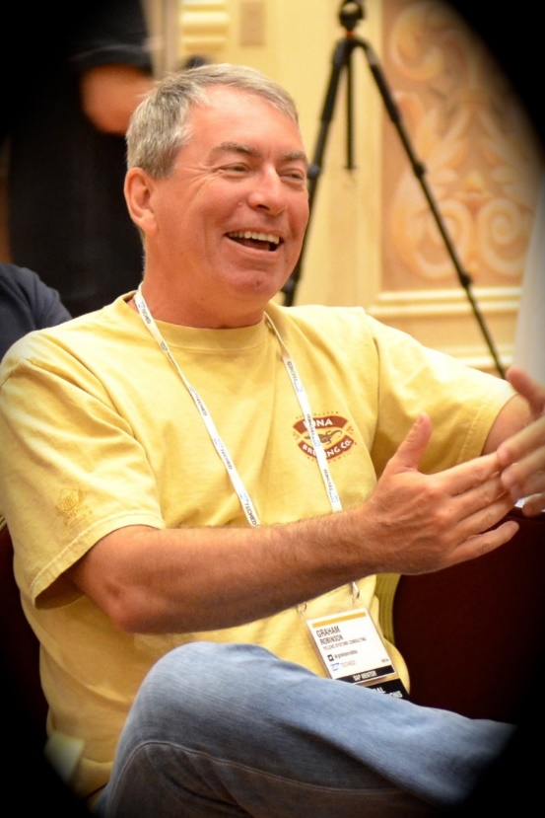



Introduction
@grahamrobbo
*Photo by Martin Gillet

Slide 3
Agenda
Some Warnings
Service Design
Code patterns for reusability
Code patterns for extensibility

Slide 4
Agenda
Some Warnings
Service Design
Code patterns for reusability
Code patterns for extensibility

Slide 5
Warning – This is not For Beginners

Slide 6

Warning - Homework
https://grahamrobbo.github.io/teched16_example/
To install you will also need abapGit
https://abapGit.org

Slide 7
Warning – focus on consumption
These code patterns can apply to all actions – but I will focus on consumption
GET_ENTITYSET is more complex because it needs to supports oData query options
CDS views (NW 7.40 SP8) provide other consumption options

Slide 8
Warning – I do not have all the answers

Slide 9
Agenda
Some Warnings
Service Design
Code patterns for reusability
Code patterns for extensibility

Slide 10
Service Design Principles
Design for Consumers
Think oData i.e. Entities, Associations, etc.
Leave SAP domain knowledge at the door
REST API’s should be self-describing
Function Imports should be for special cases

Slide 11
General Theory of API Design

Slide 12
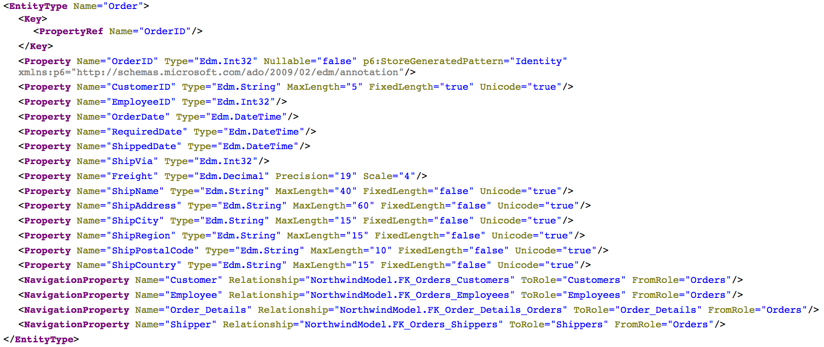
Consumer View of API
Source: http://services.odata.org/northwind/northwind.svc/$metadata

Slide 13
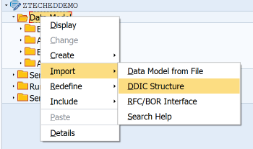
Bind Entity to DDIC Structure

Slide 14
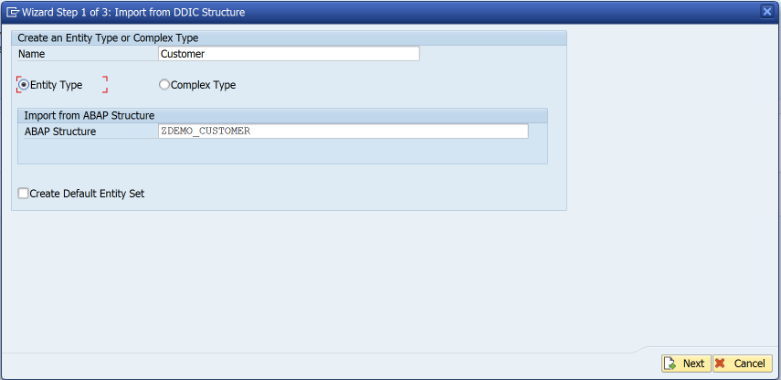
Bind Entity to DDIC Structure

Slide 15
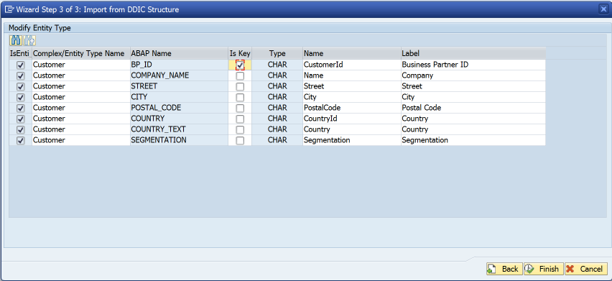
Bind Entity to DDIC Structure

Slide 16
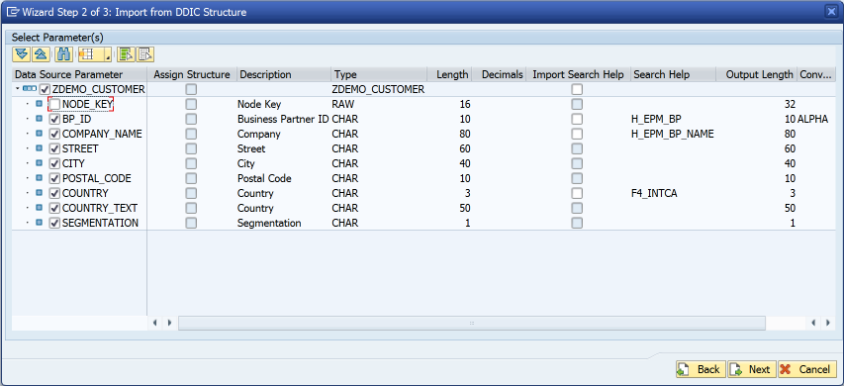
Bind Entity to DDIC Structure

Slide 17
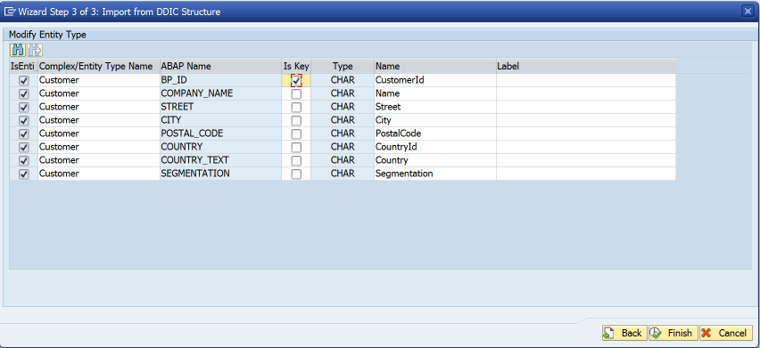
Bind Entity to DDIC Structure
Remove label suggestions
This means labels are determined at runtime rather than design-time

Slide 18
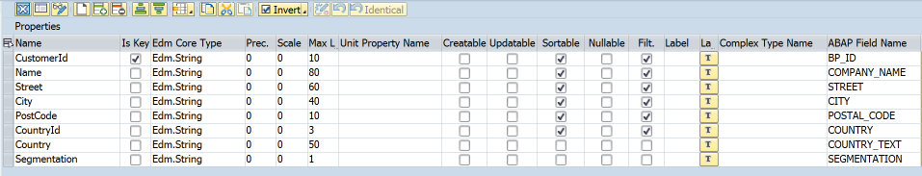
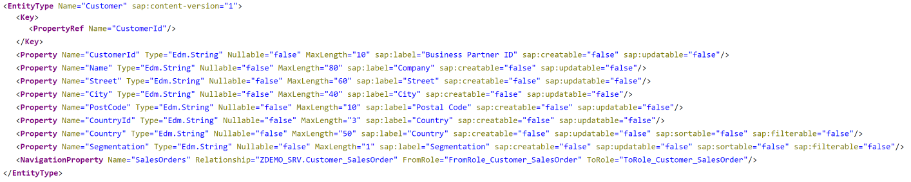
$metadata

Slide 19
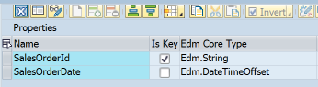
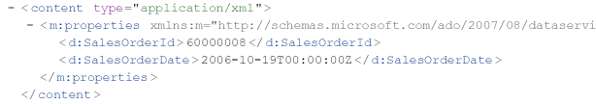
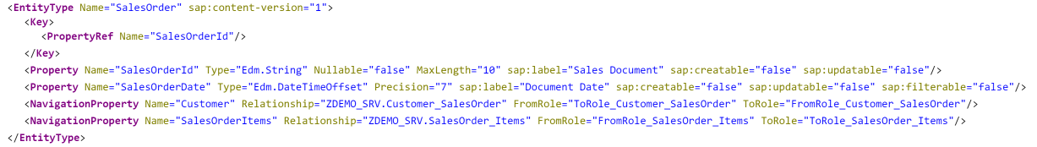
Dates & Times
Use Edm.DateTimeOffset for date/time/timestamp properties
Don’t be tempted to use Edm.String “for convenience”
Edm.DateTime replaced in oData V4 specification

Slide 20
Agenda
Some Warnings
Service Design
Code patterns for reusability
Code patterns for extensibility

Slide 21
Code patterns for Reusability
The first rule of reusability is encapsulate all business logic in concrete classes

Slide 22
What a class is not
An ABAP class that only contains static methods is not really a class…..
… in all respects except object type it is a...
Function Group

Slide 23
Code patterns for Reusability
The second rule of reusability ENCAPSULATE ALL BUSINESS LOGIC IN CONCRETE CLASSES

Slide 24
Code patterns for reusability
I like the singleton design pattern in ABAP
Be aware that some people don’t
I don’t care – it works for me
I like getters (& sometimes setters)
Be aware that some people don’t
I don’t care – it works for me
You can implement business logic however you like… just remember the first & second rules of reusability

Slide 25
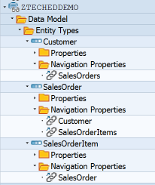
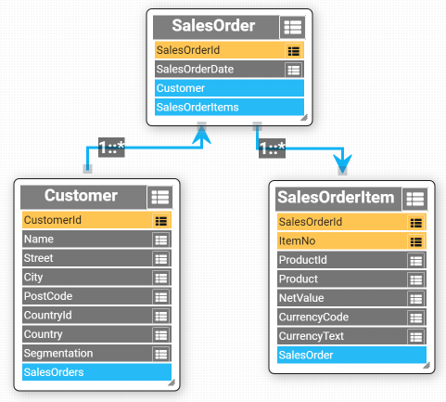
Sample Data Model
Based upon SAP Enterprise Procurement Model

Slide 26
Data Provider Class
DPC
Class

Slide 27
Multiple consumers
DPC
DPC
DPC
Class

Slide 28
Multiple consumers
DPC
DPC
DPC
Common Interface
Class

Slide 29
Replicate GW Method Interface

Slide 30
Avoid Using Deprecated Parameters
https://blogs.sap.com/2017/02/01/avoid-using-deprecated-sap-gateway-apis-in-your-odata-service-implementation/
Nabi Zamani

Slide 31
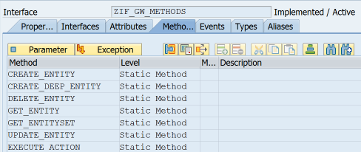
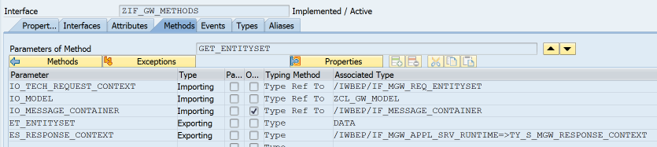
Common Interface
Model
Message Container
Untyped data object

Slide 32
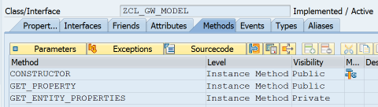
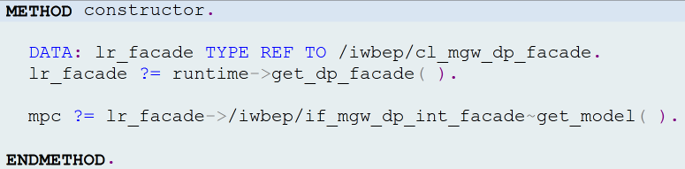
ZCL_GW_MODEL

Slide 33
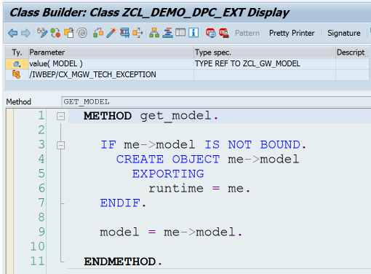
DPC->GET_MODEL

Slide 34
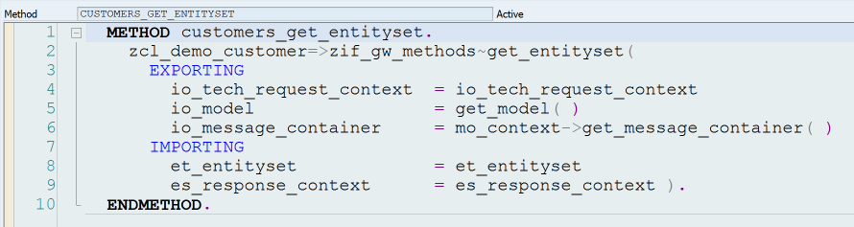
Call BO Class from DPC

Slide 35
oDATA Operations
 | Identify Primary Key(s) | Instantiate Class | Call class methods | Fill Entity
Create
Read
Update
Delete

Slide 36
get_entity
Identify primary key(s)
Instantiate BO class
Fill entity

Slide 37
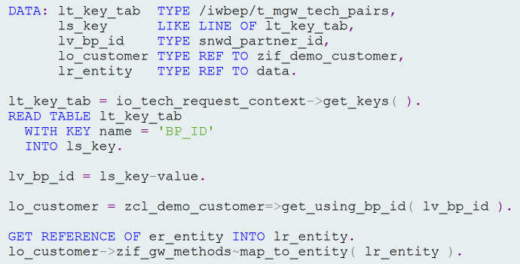
get_entity V1

Slide 38
get_entity V1 – Identify Primary Key

Slide 39
get_entity V1 – Instantiate BO Class

Slide 40
get_entity V1 – Fill Entity

Slide 41
get_entity V2

Slide 42
get_entity V2
lt_key_tab = io_tech_request_context->get_keys( ). READ TABLE lt_key_tab with KEY name = 'BP_ID' into ls_key. lv_bp_id = ls_key-value. lo_customer = zcl_demo_customer=>get_using_bp_id( lv_bp_id ). GET REFERENCE OF er_entity INTO lr_entity. lo_customer->zif_gw_methods~map_to_entity( lr_entity ).

Slide 43
get_entity V2 – Table Expression
lt_key_tab = io_tech_request_context->get_keys( ). lv_bp_id = lt_key_tab[ name = 'BP_ID' ]-value.
lo_customer = zcl_demo_customer=>get_using_bp_id( lv_bp_id ). GET REFERENCE OF er_entity INTO lr_entity. lo_customer->zif_gw_methods~map_to_entity( lr_entity ).

Slide 44
get_entity V2 – CONVersion Operator
lt_key_tab = io_tech_request_context->get_keys( ).
lo_customer = zcl_demo_customer=>get_using_bp_id( CONV #( lt_key_tab[ name = 'BP_ID' ]-value ) ).
GET REFERENCE OF er_entity INTO lr_entity. lo_customer->zif_gw_methods~map_to_entity( lr_entity ).

Slide 45
get_entity V2 – REFerence Operator
lt_key_tab = io_tech_request_context->get_keys( ).
lo_customer = zcl_demo_customer=>get_using_bp_id( CONV #( lt_key_tab[ name = 'BP_ID' ]-value ) ).
lo_customer->zif_gw_methods~map_to_entity(
REF #( er_entity ) ).

Slide 46
get_entity V2
lt_key_tab = io_tech_request_context->get_keys( ). lo_customer = zcl_demo_customer=>get_using_bp_id( CONV #( lt_key_tab[ name = 'BP_ID' ]-value ) ). *--------------------------------------------------------* * For update operations we would call class methods here * *--------------------------------------------------------*
lo_customer->zif_gw_methods~map_to_entity(
REF #( er_entity ) ).

Slide 47
get_entity V2 – Method Chaining
lt_key_tab = io_tech_request_context->get_keys( ). zcl_demo_customer=>get_using_bp_id( CONV #( lt_key_tab[ name = 'BP_ID' ]-value )
)->zif_gw_methods~map_to_entity( REF #( er_entity ) ).

Slide 48
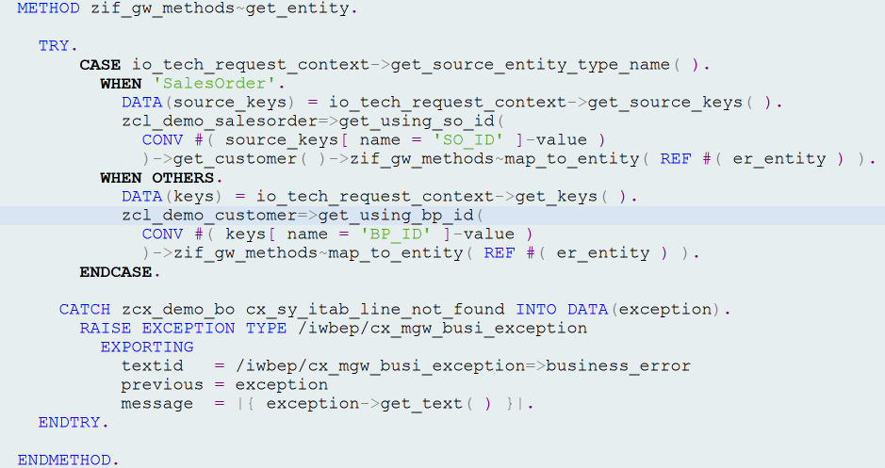
zif_gw_methods~get_entity

Slide 49
zif_gw_methods~get_entity
Exception handling

Slide 50
zif_gw_methods~get_entity
Use salesorder key to get customer

Slide 51
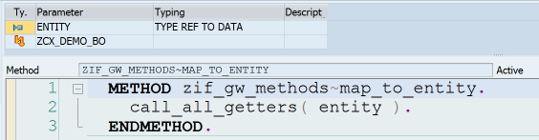
Map_to_entity

Slide 52
Map_to_entity

Slide 53
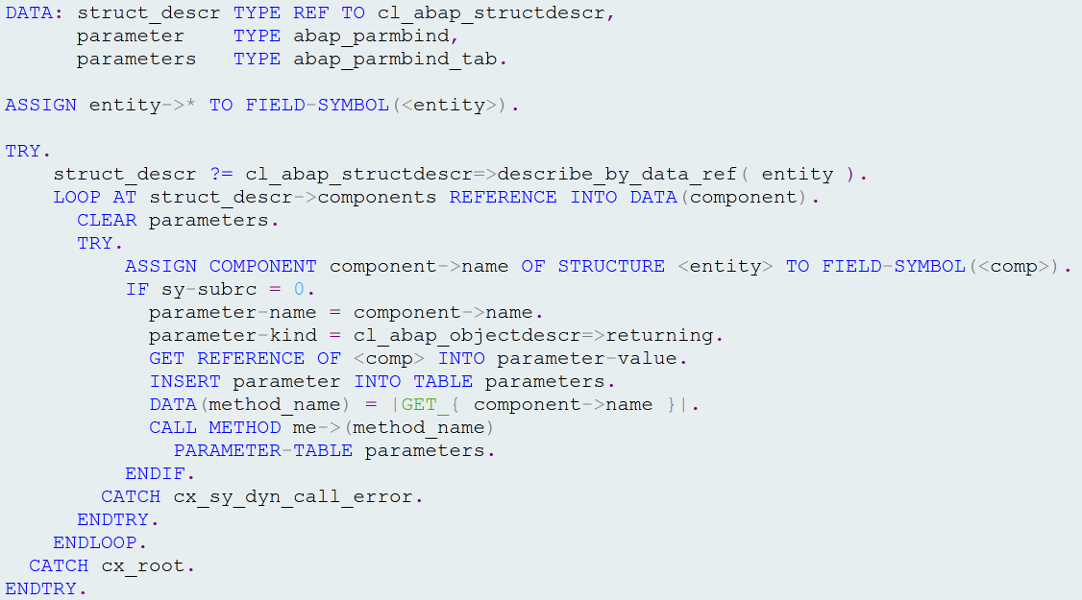
Call_all_getters
For each entity component we attempt
to call matching getter functional method
e.g <entity>-prop1 = me->get_prop1( ).

Slide 54
GET_EntitYSET
Just like GET_ENTITY in a loop…except…

Slide 55
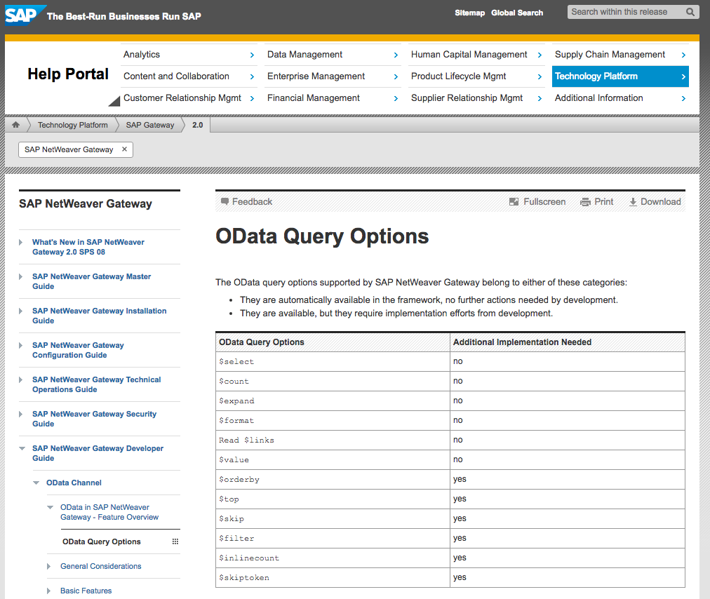
oData Query Options

Slide 56
oData Query Options

Slide 57
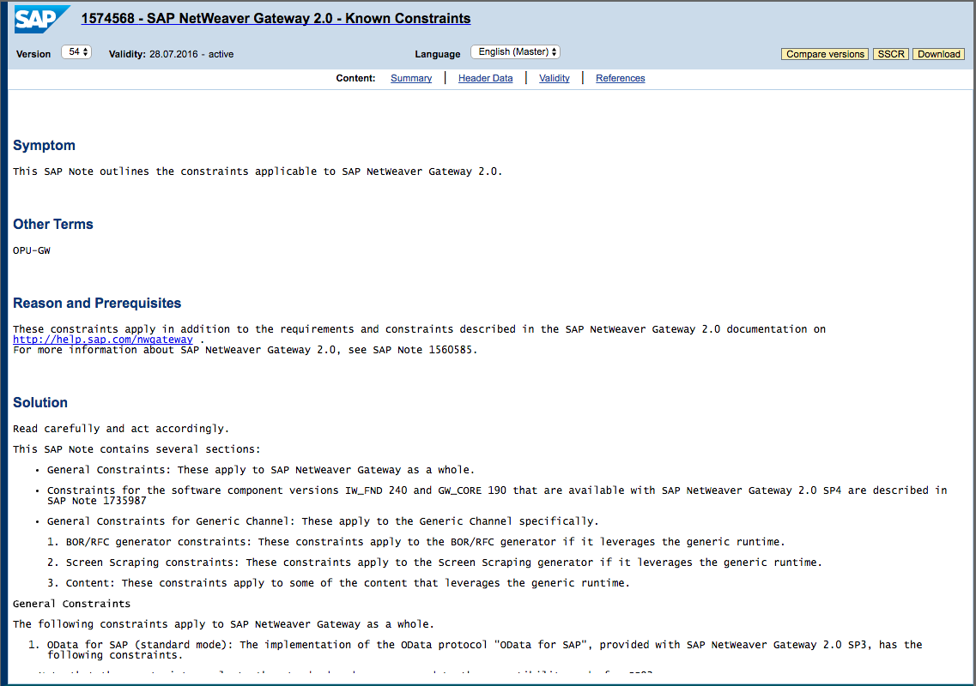
Known Constraints
SAP Note 1574568

Slide 58
zif_gw_methods~get_entityset
Goal is to identify primary key(s) as quickly as possible and use them to fill entities.

Slide 59
zif_gw_methods~get_entityset
Create anonymous data object
$orderby
$filter
$inlinecount
$top & $skip
$count
$skiptoken
Fill entities

Slide 60
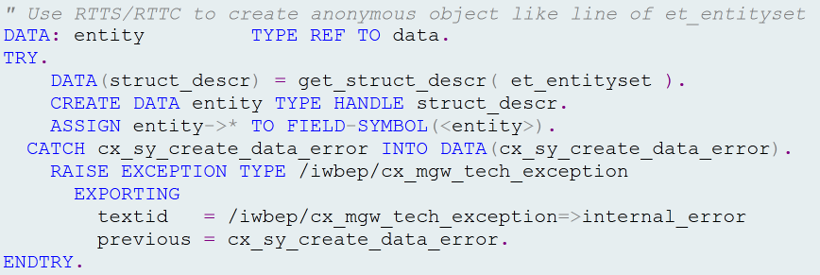
Create Anonymous data Object

Slide 61
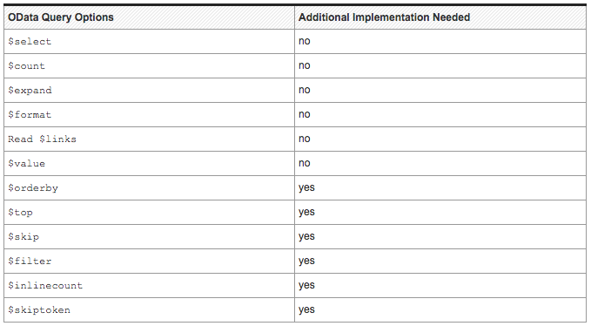
$orderby

Slide 62
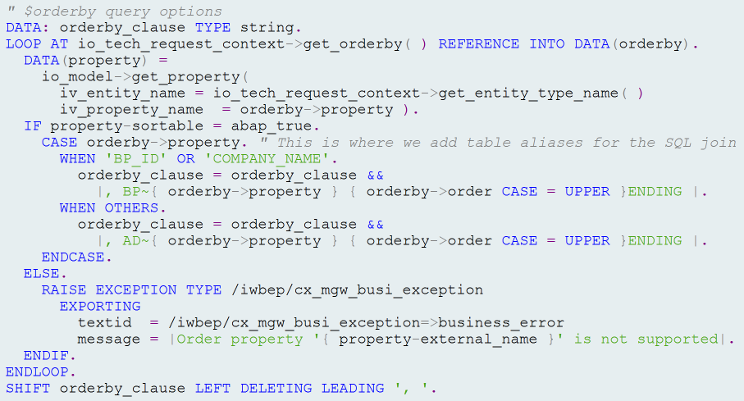
$orderby

Slide 63
$filter

Slide 64
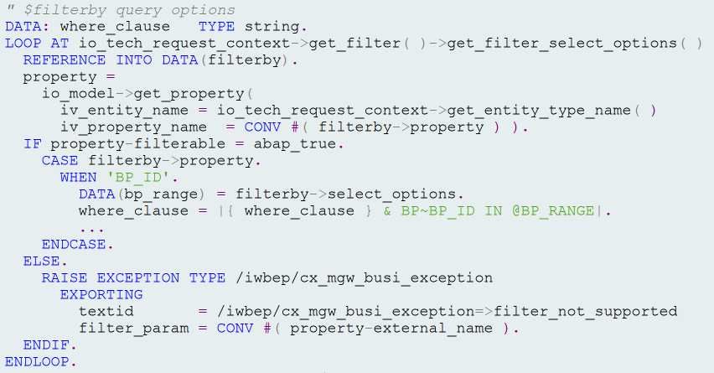
$filter

Slide 65
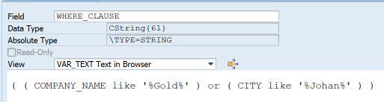
Complex $filter Queries
$filter=substringof(‘Gold’,Name) or substringof(‘Johan’,City)
*Note where_clause may require modification e.g. Table aliases, etc.

Slide 66
$Inlinecount

Slide 67

$inlinecount

Slide 68
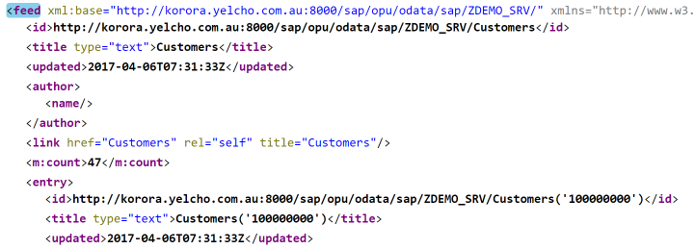
$inlinecount

Slide 69
$top & $skip

Slide 70
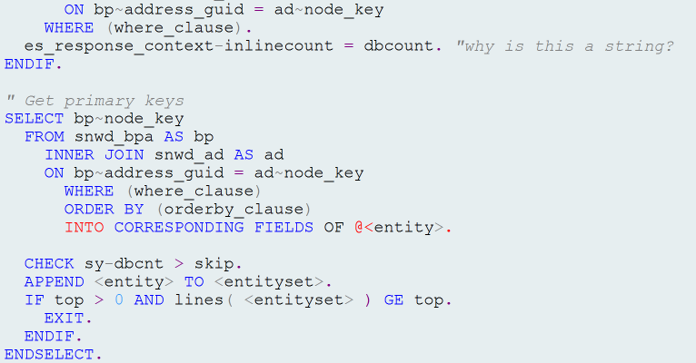
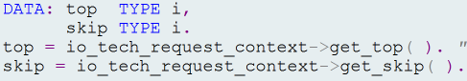

$top & $skip

Slide 71
$count

Slide 72
$count

Slide 73
$SKIPTOKEN

Slide 74
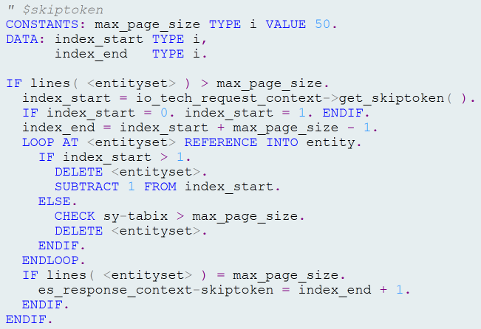
$skiptoken

Slide 75
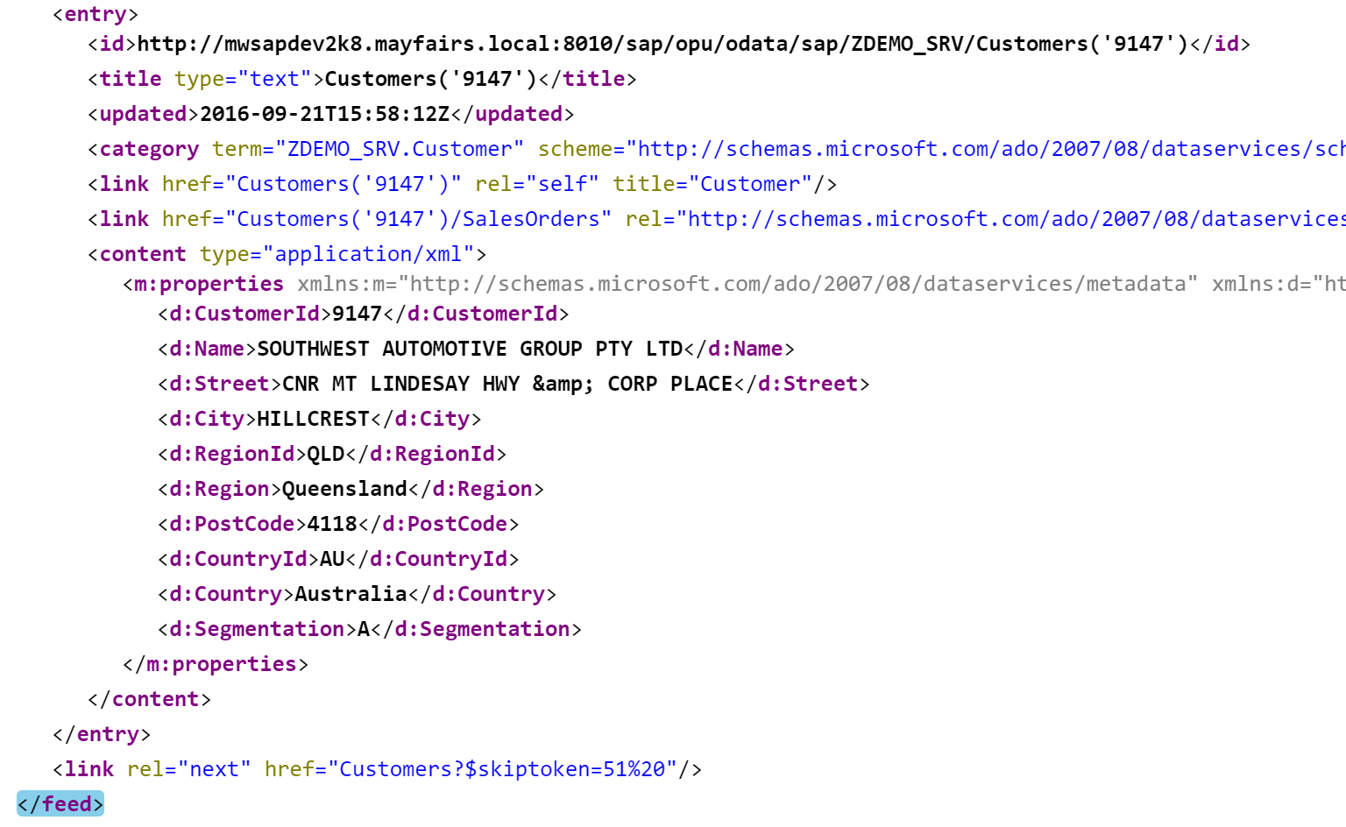
$skiptoken

Slide 76
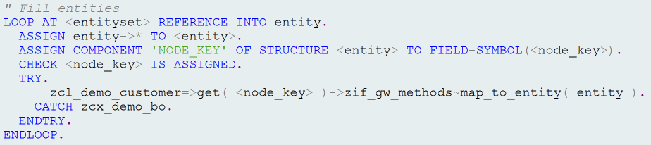
Fill Entities

Slide 77
Where Is The Code?
https://grahamrobbo.github.io/teched16_example/
To install you will also need abapGit
https://abapGit.org

Slide 78
Agenda
Some Warnings
Service Design
Code patterns for reusability
Code patterns for extensibility

Slide 79
Code Patterns for Extensibility
Mainline code built on central development server
Mainline code deployed to customer system via abapGit
Need to be able to add customer-specific code without changing mainline code

Slide 80
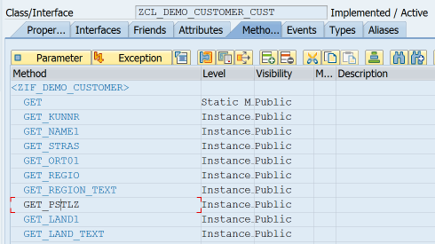
BO Class subclass
New methods or redefine existing methods

Slide 81
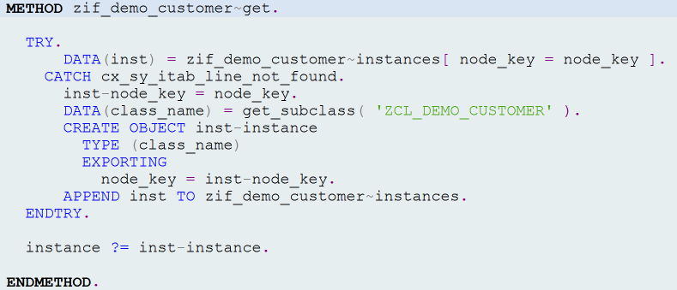
BO Class INSTANTIATION

Slide 82
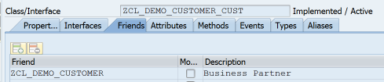

BO Class INSTANTIATION

Slide 83
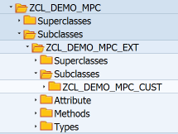
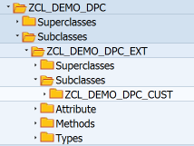
DPC & MPC classes

Slide 84
DPC & MPC subclasses

Slide 85
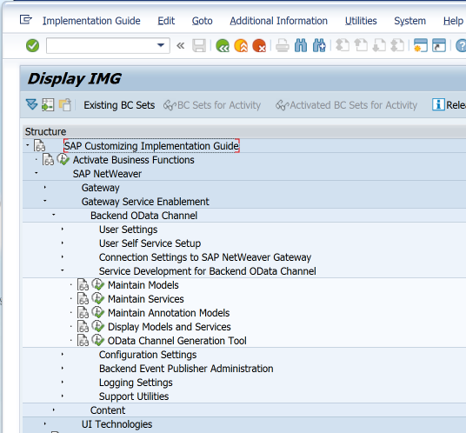
Maintain GW Models & Services

Slide 86
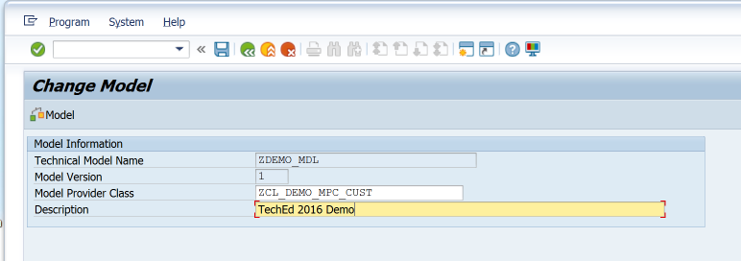
/IWBEP/R_DST_MODEL_BUILDER

Slide 87
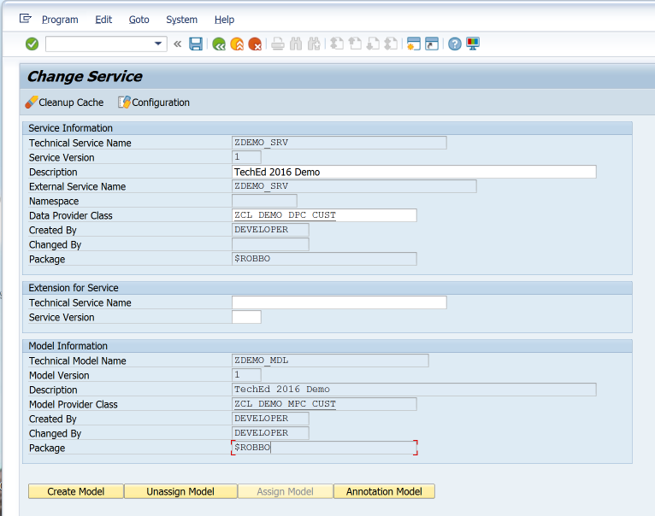
/IWBEP/R_DST_SERVICE_BUILDER

Slide 88
Extend GW Service
Create or Enhance DDIC structure
Enhance model definition in MPC
Add code to fill new entities/properties

Slide 89
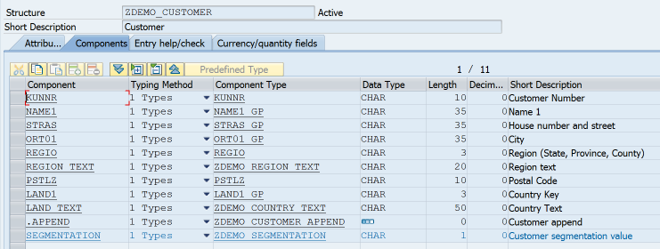
Enhance DDIC Structure

Slide 90
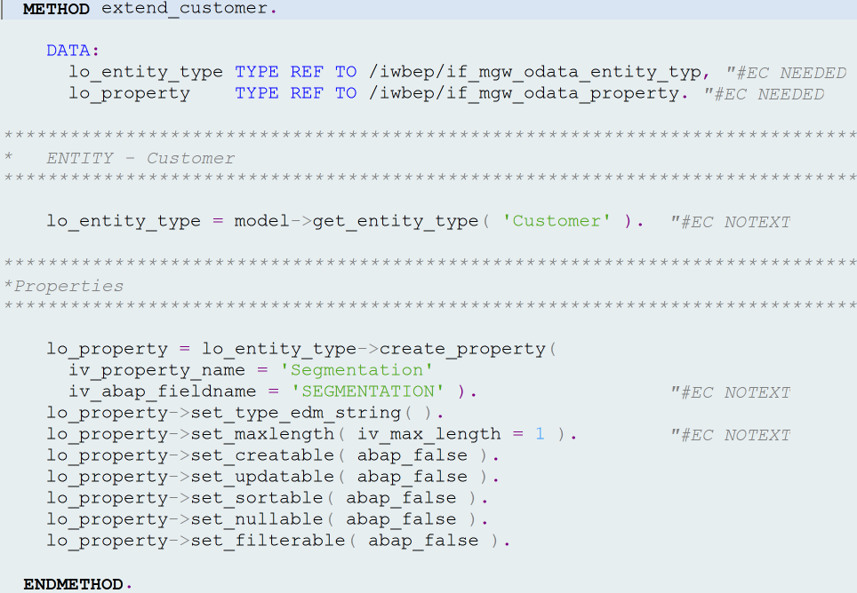
Enhance Model

Slide 91
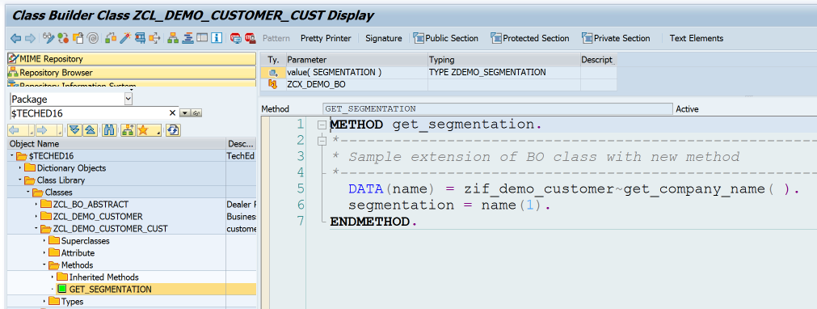
Fill new property

Slide 92
Summary
Service Design
Design for consumers
Code patterns for reusability
The first & second rule
Code patterns for extensibility

Slide 93
Where Is The Code?
https://grahamrobbo.github.io/teched16_example/
To install you will also need abapGit
https://abapGit.org

Slide 94
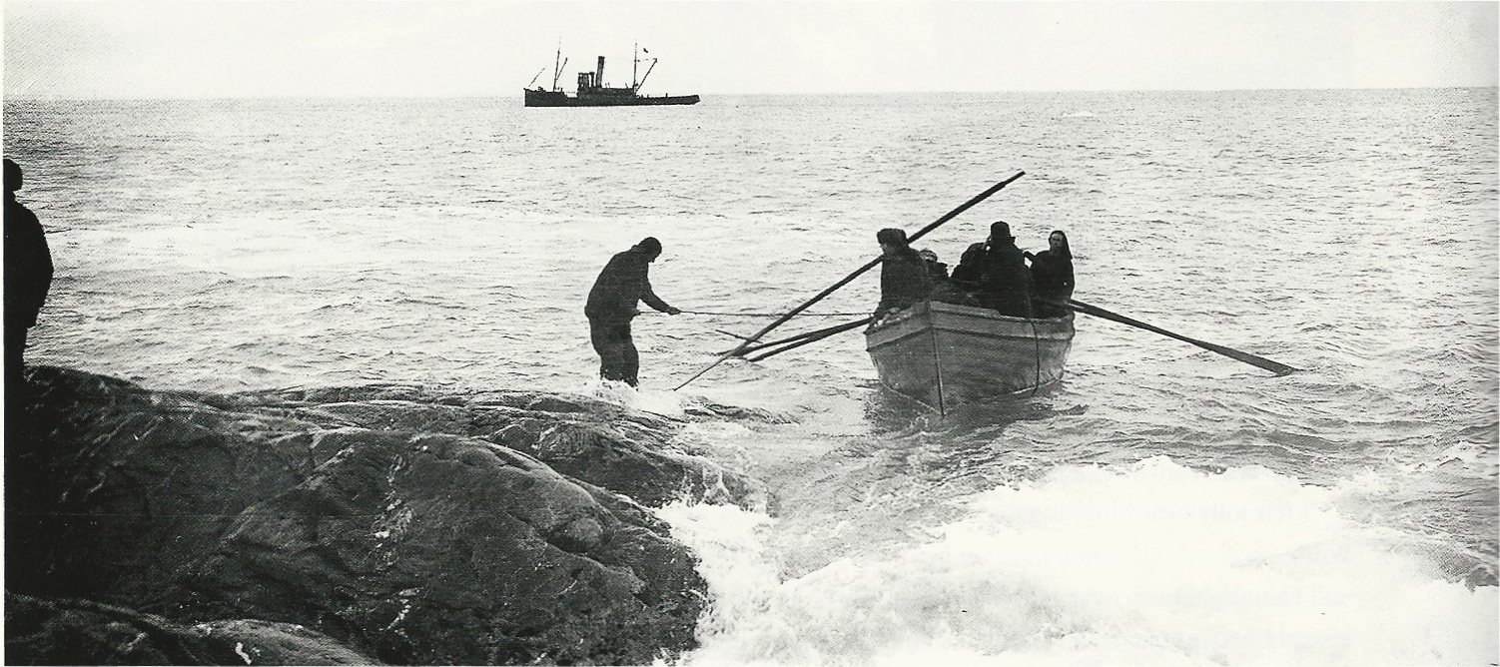


@grahamrobbo
Photo by Frank Hurley – used with permission

Slide 95

Thank You
Thank you for your time

